Slide 1
Chapter Ten
Mindfulness, Flow, and Spirituality
Positive Psychology: The Scientific and Practical Explorations of Human Strengths © 2014 SAGE

Slide 2
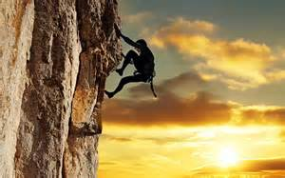
Introduction
Mindfulness, flow and spirituality involve searches for optimal experiences
Positive Psychology: The Scientific and Practical Explorations of Human Strengths © 2014 SAGE

Slide 3
Optimal Experiences
Moment-to-Moment Experiences
20,000 moments of 3 seconds each 16hr day
Where do all those moments go?
What did you do with all those moments yesterday? Today?
Chapter focuses on enriching life experiences by adding/recognizing more novelty (mindfulness), absorption (flow), and attention to the sacred (spirituality)
Positive Psychology: The Scientific and Practical Explorations of Human Strengths © 2014 SAGE

Slide 4

Mindfulness: Search for Novelty
Wrzesniewski studied people at work
  hospital cleaners: those who considered their work “a calling” were more mindful…resulted in benefits for others
Positive Psychology: The Scientific and Practical Explorations of Human Strengths © 2014 SAGE

Slide 5
Mindfulness: Novelty
Ellen Langer, Harvard
  Mindfulness represents a cognitive style that centers on awareness and the quality of attention we bring to everyday experiences
  Research on perceived control in older adults in residential care…given plant to care for and told they could make their own decisions…more alert and happier
    1.5 yrs later more cheerful, alert, active
  Value of “minding” daily choices…not moving through life on automatic pilot
Positive Psychology: The Scientific and Practical Explorations of Human Strengths © 2014 SAGE

Slide 6
Mindfulness (Wikipedia)
The psychological process of bringing one's attention to the internal and external experiences occurring in the present moment, which can be developed through the practice of meditation and other training
Psychology research: mindfulness used in:
  Decreasing depressive symptoms
  Reducing stress and anxiety
  The treatment of drug addiction
  Attenuating pain
Positive Psychology: The Scientific and Practical Explorations of Human Strengths © 2014 SAGE

Slide 7
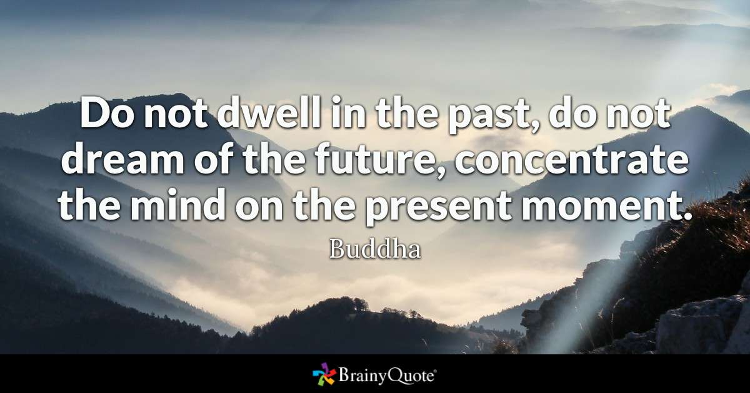
Positive Psychology: The Scientific and Practical Explorations of Human Strengths © 2014 SAGE

Slide 8
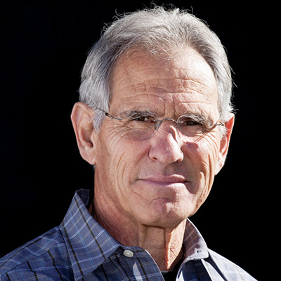
Mindfulness
Jon Kabat-Zin
Professor Emeritus and creator of the Stress Reduction Clinic and the Center for Mindfulness in Medicine, Health Care, and Society at the University of Massachusetts Medical School
The practice has moved from a largely obscure Buddhist concept founded about 2,600 years ago to a mainstream psychotherapy construct today (apa.org)
Positive Psychology: The Scientific and Practical Explorations of Human Strengths © 2014 SAGE

Slide 9
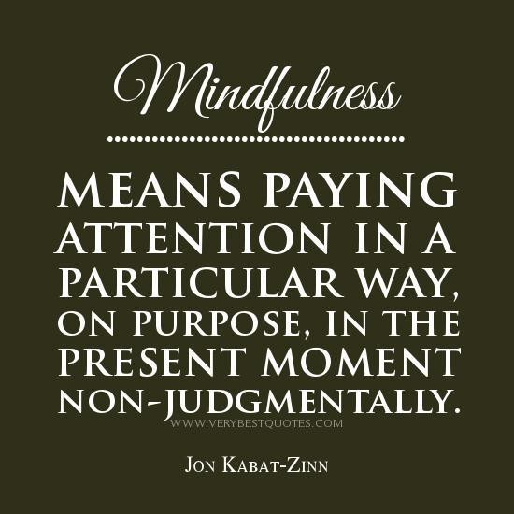
Positive Psychology: The Scientific and Practical Explorations of Human Strengths © 2014 SAGE

Slide 10

Mindfulness
Langer: 3 Core Qualities
Mindfulness can help us:
  Create new categories of experience
  Be open to new information
  Enable us to see more than one point of view
  “stop and smell the roses”
Positive Psychology: The Scientific and Practical Explorations of Human Strengths © 2014 SAGE

Slide 11
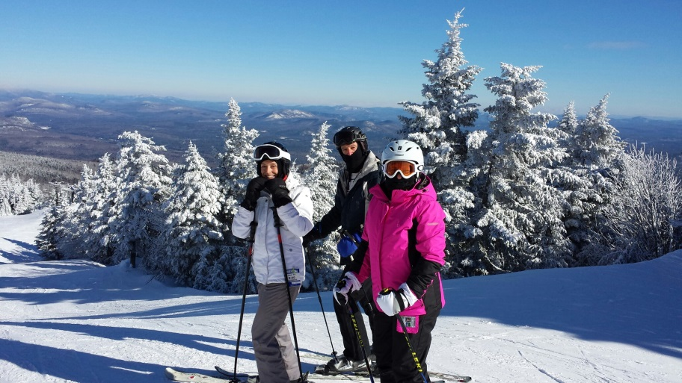
Mindfulness
Mindfulness =
health and well-being
Age related decline partially due to accepting negative stereotypes…mindfully not accepting these = age better (recall research of 75yo men who lived for 1wk as if year was 20yrs prior)
Positive Psychology: The Scientific and Practical Explorations of Human Strengths © 2014 SAGE

Slide 12
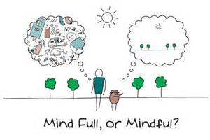
Mindfulness as a State of Mind
Not very well understood
A flexible state of mind
Openness to and active search for novelty
Present-focus
Positive Psychology: The Scientific and Practical Explorations of Human Strengths © 2014 SAGE

Slide 13

Mindfulness
Peaceful Warrior movie
  Clear your mind
  Take out the trash
  Clear your mind
  Take out the trash
Positive Psychology: The Scientific and Practical Explorations of Human Strengths © 2014 SAGE

Slide 14
Mindfulness as a State of Mind
Being mindful requires:
1. Overcoming the desire to reduce uncertainty in daily life
2. Overriding engagement in automatic behaviors (e.g., when the phone rings)
3. Decreasing evaluations of self, others, & situations
Positive Psychology: The Scientific and Practical Explorations of Human Strengths © 2014 SAGE

Slide 15
Mindfulness as a State of Mind
Bishop and colleagues (2004)
2 component system of mindfulness:
  Self-regulated attention (cognitive component)
    Hones on current personal experience
  Emotional openness (emotional component)
    Facilitates the acceptance and appreciation of all internal experiences
Positive Psychology: The Scientific and Practical Explorations of Human Strengths © 2014 SAGE

Slide 16
Living with Mindfulness
Mindfulness Meditation
  Increasing one’s awareness and making mind more receptive to current situation and internal states
  Fully embracing current life situation and internal states
Being Mindful of Emotions
  Can learn to be less judgmental which can bring about a more relaxed state
Being Mindful of Eating
  Look at the food you are about to eat
  Focus on what it consists of
  Ask yourself, “Do I still want to take this food into my body?”
  Pay close attention to every bite. Food eaten mindfully will be easier to digest, and you will be less likely to overeat.
Positive Psychology: The Scientific and Practical Explorations of Human Strengths © 2014 SAGE

Slide 17

Mindfulness as a State of Mind
Definition of mindfulness by practitioners:
  Attending nonjudgmentally to all stimuli in the internal & external environments
Positive Psychology: The Scientific and Practical Explorations of Human Strengths © 2014 SAGE

Slide 18
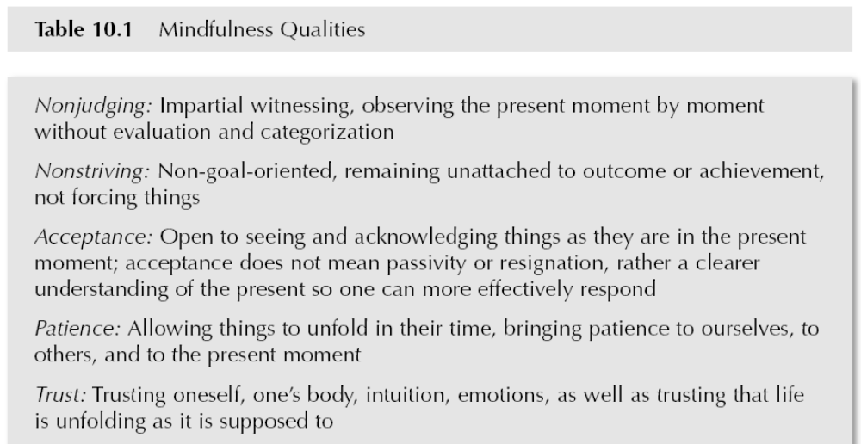
Mindfulness Qualities
Positive Psychology: The Scientific and Practical Explorations of Human Strengths © 2014 SAGE
Notes:
Check to see if table number is correct

Slide 19
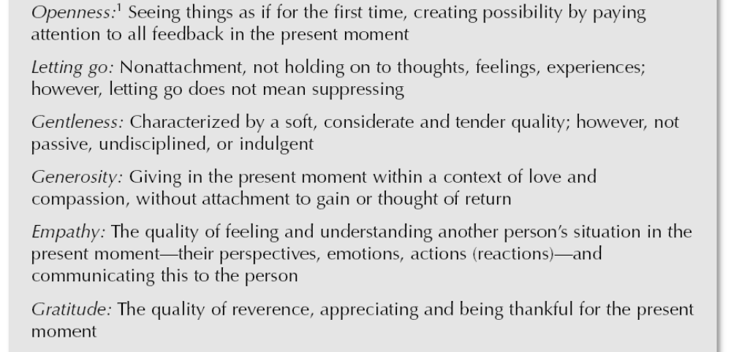
Mindfulness Qualities
Positive Psychology: The Scientific and Practical Explorations of Human Strengths © 2014 SAGE

Slide 20
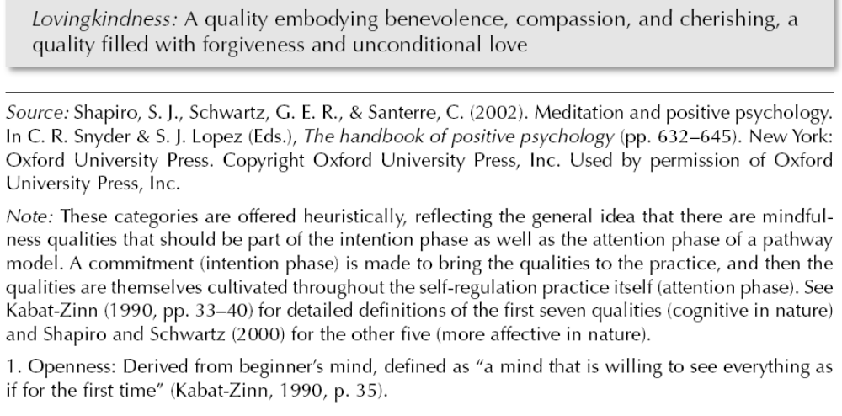
Mindfulness Qualities
Positive Psychology: The Scientific and Practical Explorations of Human Strengths © 2014 SAGE

Slide 21
Benefits of Mindfulness
Aim of mindfulness meditation:
“development of deep insight into the nature of mental processes, consciousness, identity, and reality, and the development of optimal states of psychological well-being and consciousness”- Walsh, 1983
Concept of mindfulness meditation involves making the mind more receptive to one’s current situation and internal states
Positive Psychology: The Scientific and Practical Explorations of Human Strengths © 2014 SAGE

Slide 22
Living With Mindfulness
( The Women’s Heart Foundation)
Mindfulness meditation helps manage stressful situations
Increased awareness resulting from
Being mindful of emotions (learn to be less judgmental)
Being mindful of eating
Mindful stretching exercises
Mindful breathing and sitting
Positive Psychology: The Scientific and Practical Explorations of Human Strengths © 2014 SAGE

Slide 23
Benefits of Mindfulness
Jon Kabat- Zinn, U. of Massachusetts
  Adapted ancient Eastern meditation practices for 8 wk stress reduction program
  Created a form of mindfulness meditation for use with chronic pain and anxiety
  Measured stress hardiness (commitment, control, challenge) and sense of coherence (ability to find world meaningful and manageable)
  Findings
    Hardiness and coherence improvement
    3yr follow-up: initial gains maintained
Positive Psychology: The Scientific and Practical Explorations of Human Strengths © 2014 SAGE

Slide 24
Research on the
Benefits of Mindfulness
For medical and pre-med students
  Meditation…increased levels of empathy, decreased levels of anxiety and depression
For cancer patients
  Increases in mindfulness…declines in mood disturbances and stresses
For adolescents with mental illness
  Mindfulness stress reduction…decreases in depressive and anxious symptomatology, lowed somatic complaints; increases in quality of sleep and positive feelings about themselves
Positive Psychology: The Scientific and Practical Explorations of Human Strengths © 2014 SAGE

Slide 25
Research on the Benefits of Mindfulness
Mindfulness for more than stress relief!
      Mindful parenting
      Increased spiritual experiences
      Functionality may be limited in threatening environments
Positive Psychology: The Scientific and Practical Explorations of Human Strengths © 2014 SAGE

Slide 26
Neurological Findings with Mindfulness
Improving mindfulness related to
Better spatial abilities
Increased ability for awareness
Potential increased neuroplasticity in the brain
Positive Psychology: The Scientific and Practical Explorations of Human Strengths © 2014 SAGE

Slide 27
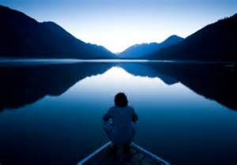
Cultivating Mindfulness
      Counseling students engaged in mindfulness-inducing techniques:
        Enhancement of counseling skills
        Increased counseling self-efficacy
Positive Psychology: The Scientific and Practical Explorations of Human Strengths © 2014 SAGE

Slide 28
Mindfulness-based Cognitive Therapy
Purpose: to aid in preventing relapses in depression
Components:
  CBT, cognitive-behavioral therapy
  Mindfulness and mindfulness-meditation
  Educating the person about depression
Positive Psychology: The Scientific and Practical Explorations of Human Strengths © 2014 SAGE

Slide 29
Mindfulness-based Cognitive Therapy
Goal of MBCT is to interrupt automatic processes and teach participants to focus less on reacting to incoming stimuli, and instead accepting and observing them without judgment. This mindfulness practice allows the participant to notice when automatic processes are occurring and to alter their reaction to be more of a reflection. Research supports the effects of MBCT in people who have been depressed three or more times and demonstrates reduced relapse rates by 50%
Wikipedia

Slide 30
ACT Mindfully(Acceptance and Commitment Therapy)
Accept what is out of your personal control, and Commit to action that improves and enriches your life
ACT breaks mindfulness skills down into 3 categories:
1) defusion: distancing from, and letting go of, unhelpful thoughts, beliefs and memories
2) acceptance: making room for painful feelings, urges and sensations, and allowing them to come and go without a struggle
3) contact with the present moment: engaging fully with your here-and-now experience, with an attitude of openness and curiosity
Positive Psychology: The Scientific and Practical Explorations of Human Strengths © 2014 SAGE

Slide 31
Mindfulness Exercises for Stress Relief
Meditation
Deep breathing
Cleaning house
Observe your thoughts (try journaling)
Listening to music
  Choose soothing music
  Concentrate on sounds and vibrations and emotions experienced
  If mind wanders, congratulate self on noticing and come back to music
Positive Psychology: The Scientific and Practical Explorations of Human Strengths © 2014 SAGE

Slide 32
Mindful…
Eating
Listening (e.g., to all sounds around us, conversations,
Walking
Exercising
Leadership
Really, anything!
Positive Psychology: The Scientific and Practical Explorations of Human Strengths © 2014 SAGE

Slide 33
Benefits of Mindfulness
Self-control
Objectivity
Affect tolerance
Enhanced flexibility
Equanimity
Improved concentration and mental clarity
Emotional intelligence
The ability to relate to others and one's self with kindness, acceptance and compassion.

Slide 34
State or Trait?
What is the difference between a state and a trait?
State
  Mindfulness as a moment-to-moment awareness of one's experience without judgment
Trait
  Generally being more mindful

Slide 35
State or Trait?
Participants engaged in an 8-week mindfulness-based stress reduction (MBSR) program
Questionnaires
  State: the Toronto Mindfulness Scale completed each week, assessing their mindfulness during that 10-min practice of mindfulness
  Trait: the Five Facet Mindfulness Questionnaire, pre- and post-test
Participants engaged in a 10-minute mindfulness practice on their own (at home)
Kiken, L. G., Garland, E. L., Bluth, K., Palsson, O. S., & Gaylord, S. A. (2015). From a state to a trait: Trajectories of state mindfulness in meditation during intervention predict changes in trait mindfulness. Personality and Individual Differences, 81, 41-46. doi: 10.1016/j.paid.2014.12.044

Slide 36
State or Trait?
Large variations in the levels of self-reported state mindfulness during meditation
Employing combined latent growth and path model statistics they furthermore concluded that individual trajectories of state mindfulness predicted the changes in trait mindfulness resulting from the MBSR program: participants with higher increase in state mindfulness during their meditation practice were found to also show the largest increase in trait mindfulness from before to after the MBSR program
Kiken, L. G., Garland, E. L., Bluth, K., Palsson, O. S., & Gaylord, S. A. (2015). From a state to a trait: Trajectories of state mindfulness in meditation during intervention predict changes in trait mindfulness. Personality and Individual Differences, 81, 41-46. doi: 10.1016/j.paid.2014.12.044

Slide 37
Purpose of Mindful Meditation
To cultivate and strengthen the trait of mindfulness—enhanced present moment awareness—so you can extend it to every situation you encounter, no matter how challenging, and reap the ongoing benefits

Slide 38
Mindfulness-Based Stress Reduction Training
Illness
Fatigue
Headaches
Depression
GI distress
Chronic pain
Anxiety and panic
Sleep disturbances
High blood pressure
Compassion Fatigue
Stress — job, family or financial

Slide 39
Studied Benefits of Mindfulness Training
Cognitive benefits
Emotional benefits
Physiological benefits
Increased self-awareness
Increase in positive thoughts
Increased ability to concentrate
Increased capacity for empathy
Increased capacity for compassion
Lower blood pressure and pulse rate
Increased ability to regulate emotions
Increase in ability to be non-judgmental
Increased brain activation in regions associated with positive thoughts and mood

Slide 40
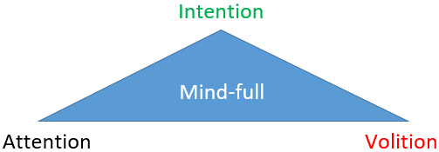
Mindfulness
Jon Kabat-Zinn
  Mindfulness is 80% experiential and 20% study

Slide 41
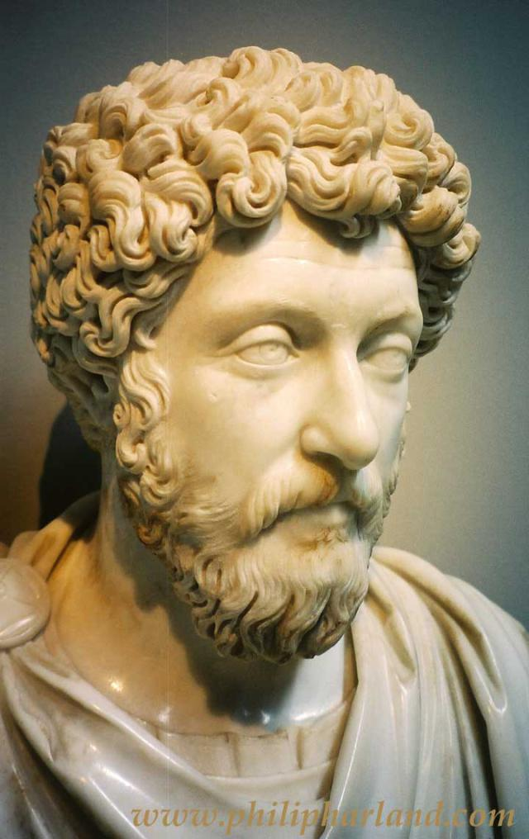
Quote
“Do every act of your life as though it were the very last act of your life.”
― Marcus Aurelius (was Emperor of Rome from 161 to 180. Marcus Aurelius was the last of the so-called Five Good Emperors)

Slide 42
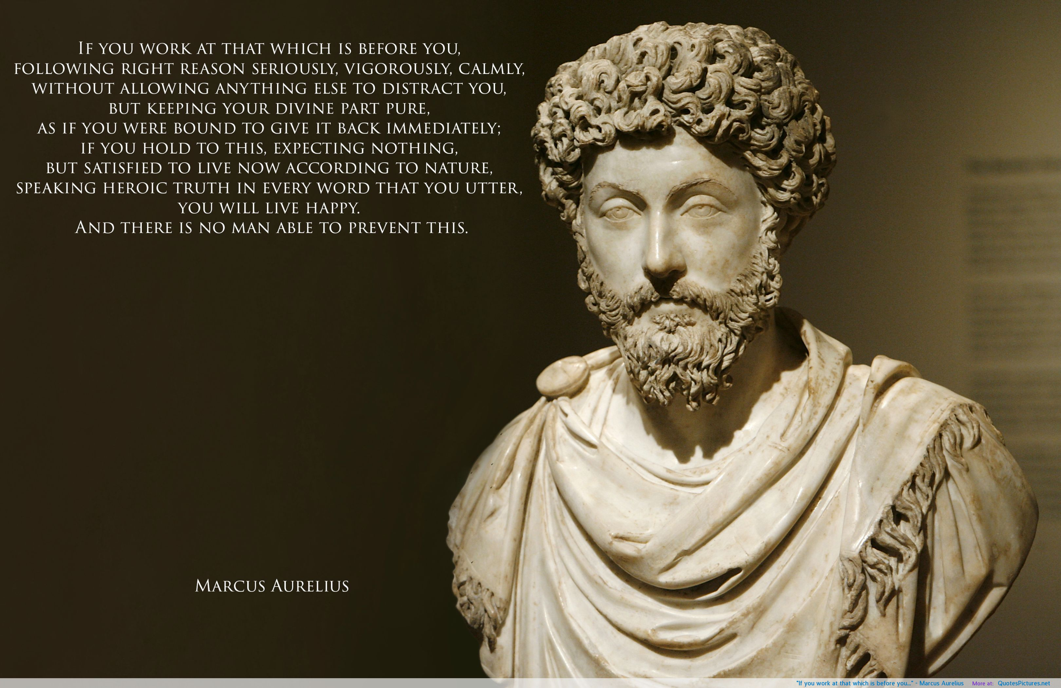

Slide 43
Flow
Mihaly “Mike” Csikzentmihalyi
- 1960s, studied the creative process
- Observed states of engagement
- Extensive interviews
- Experience sampling method
Positive Psychology: The Scientific and Practical Explorations of Human Strengths © 2014 SAGE

Slide 44
FLOW
Flow denotes the holistic sensation present when we act with total involvement…It is the state in which action follows upon action according to an internal logic which seems to need no conscious intervention on our part. We experience it as a unified flowing from one moment to the next, in which we feel in control of our actions, and in which there is little distinction between self and environment; between stimulus and response; or between past, present and future
  Csikszentmihalyi (1975, p. 43)
Positive Psychology: The Scientific and Practical Explorations of Human Strengths © 2014 SAGE

Slide 45
Flow
Survey
“do you ever get involved in something so deeply that nothing else seems to matter, and you lose track of time?”
  American and European samples found that about 20% of people report having flowlike experiences often, sometimes several times a day
  15% say that they never have that experience
Positive Psychology: The Scientific and Practical Explorations of Human Strengths © 2014 SAGE

Slide 46
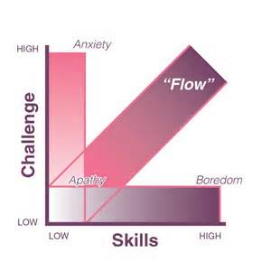
Flow
Conditions of flow:
1. challenge – skills balance
2. clear proximal goals & immediate feedback
Positive Psychology: The Scientific and Practical Explorations of Human Strengths © 2014 SAGE

Slide 47
Flow
3 Regions of momentary experiences:
  Flow (where challenges and skills are matched)
  Boredom (challenges and opportunities too easy relative to skills)
  Anxiety (demands exceed capacities)
Positive Psychology: The Scientific and Practical Explorations of Human Strengths © 2014 SAGE

Slide 48
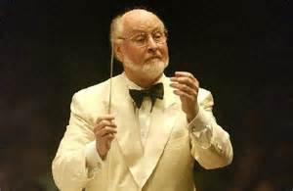
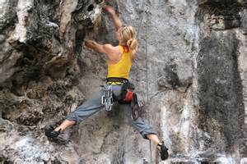
Characteristics of Flow
Subjective experience of flow:
  Intense & focused concentration
    Composer: “I am really quite oblivious to my surroundings after I really get going. I think the phone could ring…or the house could burn down…when I start working I really do shut out the world”
  Merging of action & awareness
    Rock climber “You are so involved in what you are doing, you aren’t thinking of yourself as separate from the immediate activity…you don’t see yourself as separate from what you are doing.”
Positive Psychology: The Scientific and Practical Explorations of Human Strengths © 2014 SAGE; Comptom & Hoffman, 2013

Slide 49
Characteristics of Flow
  Loss of self-consciousness
    No thinking before we act
    Music composer: “You yourself are in an ecstatic state to such a point that you feel as though you almost don’t exist…my hand seems devoid of myself, and I have nothing to do with what is happening. I just sit there watching it in a state of awe and wonderment. And it just flows out by itself.”
  Sense of control
    Dancer: “if I have enough space, I am in control. I feel I can radiate an energy into the atmosphere…It’s not always necessary that another human being be there to catch that energy. I can dance for the walls. I can dance for the floors…I become one with the atmosphere.”
Positive Psychology: The Scientific and Practical Explorations of Human Strengths © 2014 SAGE

Slide 50
Characteristics of Flow
  Distortion of temporal experience
    Chess master: “Times passes a hundred times faster. In a sense, it resembles the dream state. A whole story can unfold in seconds, it seems.”
  Process is intrinsically rewarding
    Rock climber “The mystique of rock climbing is climbing; you get to the top of the rock glad it’s over but really wish it would go forever. The justification of climbing is climbing…you don’t conquer anything except thing in yourself…The purpose of the flow is to keep on flowing, not looking for a peak or utopia but staying in the flow...There is no possible reason for climbing except the climbing itself; it is a self-communication.”
Positive Psychology: The Scientific and Practical Explorations of Human Strengths © 2014 SAGE

Slide 51
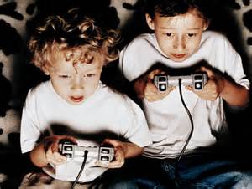
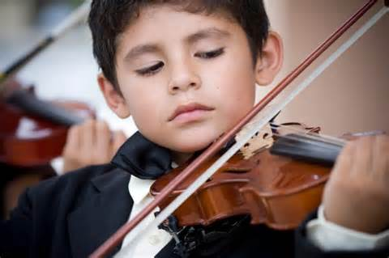

Flow
An intentional attentional process
  Intense concentration
  Merging of action and awareness
Positive Psychology: The Scientific and Practical Explorations of Human Strengths © 2014 SAGE

Slide 52
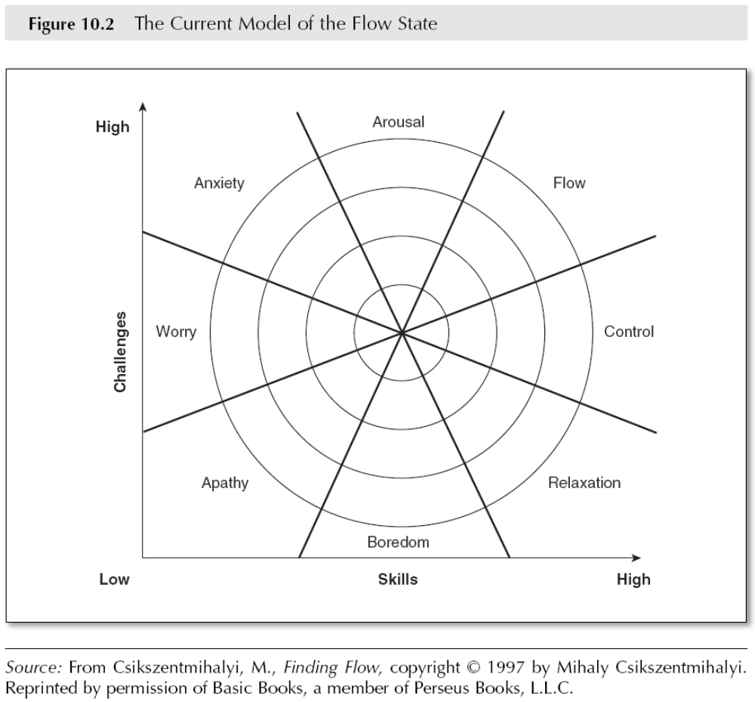
Flow
Positive Psychology: The Scientific and Practical Explorations of Human Strengths © 2014 SAGE
Notes:
Confirm that this diagram is in the book

Slide 53
Flow
Autotelic personality:
  Cluster of personality variables related to ability to achieve flow
    curiosity, persistence, low self-centeredness, and a desire of performing activities for intrinsic reasons only
  Doing things for their own sake, in the “here and now” rather than for some later goal
  Preference for high-action-opportunity, high-skills situations
  Tend to experience little stress when in flow quadrant
Positive Psychology: The Scientific and Practical Explorations of Human Strengths © 2014 SAGE

Slide 54
Flow
Longitudinal research:
- academics
- work
- sports
Adolescent commitment to a talent area predicts identification with talent four years later
Positive Psychology: The Scientific and Practical Explorations of Human Strengths © 2014 SAGE
Notes:
This slide should be switched with number 27

Slide 55
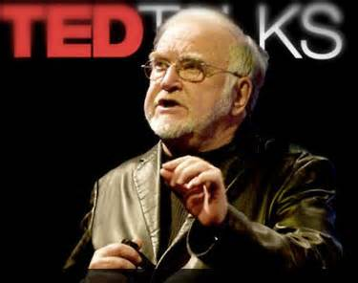
Flow
Ted Talk: Mihaly Csikszentmihalyi
Positive Psychology: The Scientific and Practical Explorations of Human Strengths © 2014 SAGE

Slide 56
Fostering Flow
2 paths to increase engagement:
1. Finding & shaping activities & environments
2. Identifying personal characteristics
& attentional skills
Applications to law enforcement, workplace design, organization of displays
Positive Psychology: The Scientific and Practical Explorations of Human Strengths © 2014 SAGE

Slide 57
Gaming and Internet Use
Some experience a flow state while engaging in gambling or technological pursuits.
Gambling and Internet may have addictive – like quality
True flow is described as constructive or beneficial
Positive Psychology: The Scientific and Practical Explorations of Human Strengths © 2014 SAGE

Slide 58
Spirituality
Spirituality is a state of mind
“The feelings, thoughts, and behaviors that arise from a search for the sacred” (Hill et al.)
There are a number of pathways in search
Universal strength of transcendence (Seligman)
Often blurred with religion and faith
Link between religiosity and happiness found in both Christians and Muslims
Positive Psychology: The Scientific and Practical Explorations of Human Strengths © 2014 SAGE

Slide 59
Spirituality
Associated with:
  mental and physical health
  managing substance abuse
  better marital functioning
  improved parenting
Positive Psychology: The Scientific and Practical Explorations of Human Strengths © 2014 SAGE

Slide 60
Spirituality
associated with:
  coping
  mortality
  well-being
  purpose & meaning
  hope & optimism
  resilience
Positive Psychology: The Scientific and Practical Explorations of Human Strengths © 2014 SAGE

Slide 61
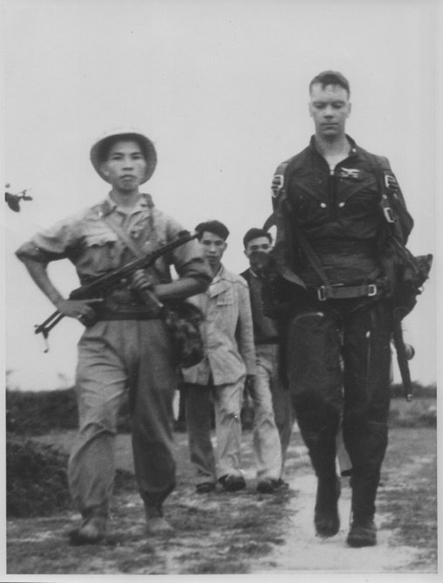
POW statement
Spirituality and Resilience
A new POW was told by a POW who had been imprisoned for some time: “The first thing you need around here, old buddy, is faith. I’m not a preacher. I’m not gonna try to convert you. I’m just gonna tell you the truth. If you can’t tap into a source of strength and power greater than yourself, you’re probably not gonna last.”
  Bob Shumaker, spent almost 8 years as a POW

Slide 62
Spirituality
How spirituality leads to positive outcomes is unclear
Connection may be bidirectional
Positive Psychology: The Scientific and Practical Explorations of Human Strengths © 2014 SAGE

